Slide 1
Employee Data Analysis using Excel
STUDENT NAME: DINESH.K
REGISTER NO: 122200857
DEPARTMENT:B.COM(CORPORATE SECRETARYSHIP)
COLLEGE: ANNAI VIOLET ARTS AND SCIENCE COLLEGE

Slide 2
PROJECT TITLE
EMPLOYEE ATTRITION ANALYSIS USING EXCEL DASHBOARD

Slide 3


AGENDA
Problem Statement
Project Overview
End Users
Our Solution and Proposition
Dataset Description
Modelling Approach
Results and Discussion
Conclusion
3/21/2024 Annual Review

Slide 4

PROBLEM STATEMENT
We have to prepare employee performance analysis using
excel because:
TO IDENTIFY AREAS TO BE DEVELOPED: This is possible when we are using excel we can identify the area to be developed.
TO IMPROVE PRODUCTIVITY: By using excel we can easily identify the improvement of productivity in an organisation.
DETERMINATION OF GOAL: The company will be using this analysis to determine the short term goal as well as long term goal of the company whether it going as per they have planned or not.
TO RECOGNITION AND REWARD: It allows to identify the employees recognition and reward to employees this help to improve them.

Slide 5

PROJECT OVERVIEW
COMMUNICATION TOOLS: This project overview serve as a highlights to the important details of the employees like employees ID, First name ,Last name ,Gender, Business unit, Employees type, Employees Status, Performance score and employees current rating etc.
PROJECT OBJECTIVES: A clear statement and data of the employees details of what the project aims to achieve. This includes the goal, expected outcomes, and any specific targets.
OVER VIEW OF THE PROJECTS: The over view of the project is a concise summary that provides key information about employees data is helps to identify the persons details and rating there performance of the employees .
DOCUMENTARY :It is the documentary details about the employees its helps to highlights the details of the employees detailed documentary in the employees data document and sored in the company documents.

Slide 6

WHO ARE THE END USERS?
Data management team
Human resource management department team
Employee department team
Managers
IT Department

Slide 7

OUR SOLUTION AND ITS VALUE PROPOSITION
CONDITIONAL FORMAT: Using this conditional format
applies a gradient colours in the blank space in the employees
data. This features is particularly useful for making data
analysis more Intuitive and easier to interpret.
FILTER: It is using to remove the blank boxes .Filter the blank boxes and it saves time to records or trends without manually searching through large datasets.
PIVOT TABLE :It is the powerful tool used to summarise, analyse, explore, and present large amount of data. It filtering the data dynamically.
PIE-CHART: It is used to visually represents the proportions or percentages of a whole data set.

Slide 8
Dataset Description
EMPLOYEE DATASET: Describing datasets effectively involves providing clear and concise information about their contents, structure, and context.
The data set contains information about employee within the organisation, including their salaries , age and gender.
Employee ID: A unique identifier for each employee.
Age: The age of the employee.
Gender: The gender of the employee (e.g., Male, Female, Non-binary).
Department: The department in which the employee works (e.g., Sales, IT, HR).
Job Role: The employee's job title or role (e.g., Software Engineer, Sales Manager).
Salary: The employee's salary.
Tenure: The number of years the employee has been with the company.
Performance Rating: A rating of the employee's performance (e.g., Excellent, Good, Average, Poor).

Slide 9

THE "WOW" IN OUR SOLUTION
=IFS(Z8>5,”VERYHIGH”Z8>=4,”HIGH”,Z8>=3”MED”,TRUE,”LOW”)
3/21/2024 Annual Review
9

Slide 10
MODELLING
SCIENTIFIC MODELLING: Used in science to simulate and understand complex system
like climate, ecosystem, or chemical reactions.
MATHEMATICAL MODELLING: Involves using mathematical equations to represent relationship between different variable within a system, often used in physical, economic, and engineering.
STATISTICAL MODELLING: Involves using statistical methods to analyses and make predictions based on data, commonly used in fields like economics, biology, and social sciences.
BUSINESS MODELLING: Involves creating representations of business processers or strategies, often to analyses financial performance or develop business plans.
Each type of modelling serves to provide insights, make predictions, or create a visual representation of something that can be used for further analysis or decision-making.
10

Slide 11
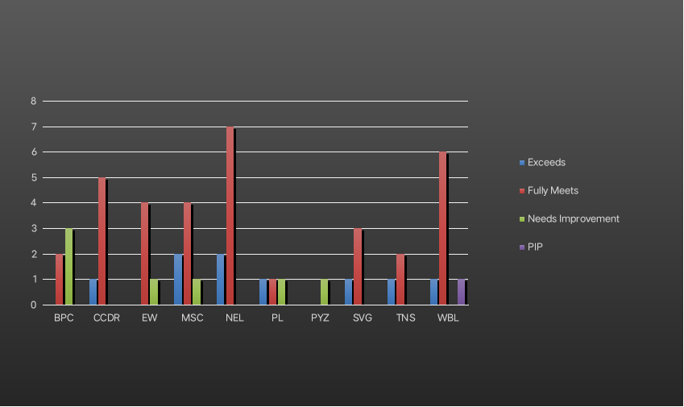
RESULTS
11

Slide 12
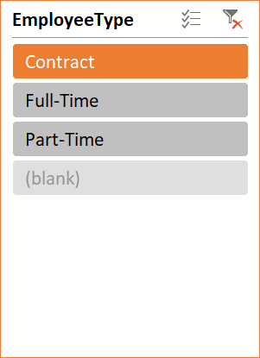
RESULTS
GenderCode | (All)
Count of FirstName | Column Labels
Row Labels | Exceeds | Fully Meets | Needs Improvement | PIP | Grand Total
BPC |  | 2 | 3 |  | 5
CCDR | 1 | 5 |  |  | 6
EW |  | 4 | 1 |  | 5
MSC | 2 | 4 | 1 |  | 7
NEL | 2 | 7 |  |  | 9
PL | 1 | 1 | 1 |  | 3
PYZ |  |  | 1 |  | 1
SVG | 1 | 3 |  |  | 4
TNS | 1 | 2 |  |  | 3
WBL | 1 | 6 |  | 1 | 8
Grand Total | 9 | 34 | 7 | 1 | 51

Slide 13
conclusion
Concluding an employee attrition analysis using Excel dashboards, you'll want to summarize the key insights, trends, and recommendations based on the data visualized in your dashboards. Here's a structured approach to help you frame your conclusion:
Overall Attrition Rate: Provide the percentage of employees leaving the organization over a specific period.
Trends Over Time: Highlight any noticeable trends in attrition rates—whether they are increasing, decreasing, or stable.
Departmental Insights: Identify which departments or teams have the highest or lowest attrition rates.
Demographic Analysis: Summarize attrition rates by factors such as age, gender, tenure, or job role.

